Slide 1

Seasonal Agriculture Performance Analysis Major Project
[Student Name :- Manjil Agamacharyya
College Name- Jorhat Institute of Science & Technology ]
AICTE STU ID : STU6a05a39f22c1a1778754463

Slide 2

PROBLEM STATEMENT
(Agricultural activities are influenced by seasonal variations in environmental conditions, farming practices, resource availability and market conditions. As a result, agricultural performance may differ from one season to another. However, raw agricultural data does not clearly explain how agricultural performance changes across seasons or what patterns can be observed in different seasonal conditions. The problem is to analyze the given agricultural dataset and investigate seasonal differences in agricultural performance by identifying meaningful patterns, trends, relationships and variations within the available data.

Slide 3
Project Description
This project aims to analyse agricultural data to understand how performance varies across different seasons. Agricultural activities are heavily influenced by seasonal changes in environmental conditions, farming practices, and resource availability.
Importance: Understanding these seasonal patterns through data analytics is crucial for stakeholders to:
Analyse variations in agricultural performance.
Identify important seasonal trends.
Compare performance across different periods.
Understand changing environmental conditions and resource usage.
Support evidence-based agricultural planning and identify areas needing further investigation.
Objectives: The primary objective is to analyse agricultural data from different seasons to identify key patterns and relationships. This involves:
Exploring, cleaning, and preparing the dataset.
Examining how agricultural performance changes across seasons.
Investigating the relationships between seasonal conditions and outcomes.
Applying statistical and visualization techniques to interpret findings and develop data-driven recommendations.

Slide 4

WHO ARE THE END USERS?
Farmers
Government

Slide 5

Technology Used
  Python
  Matplotlip.pyplot
  Seaborn
  Numpy
  Pandas

Slide 6
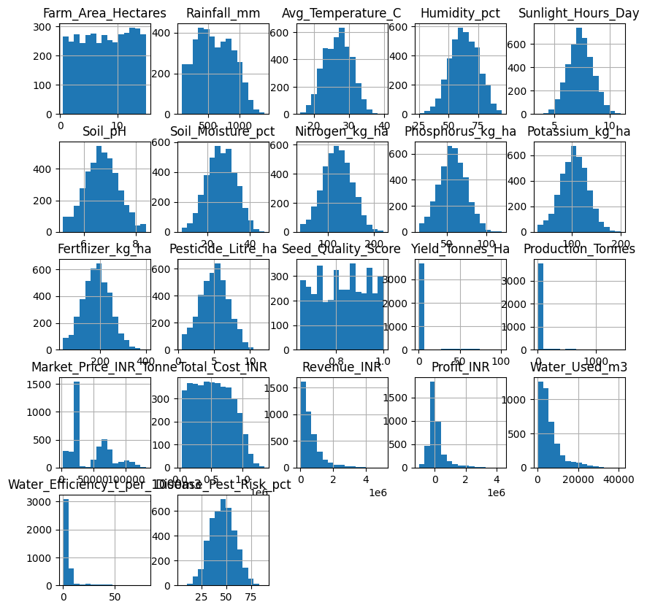
RESULTS

Slide 7
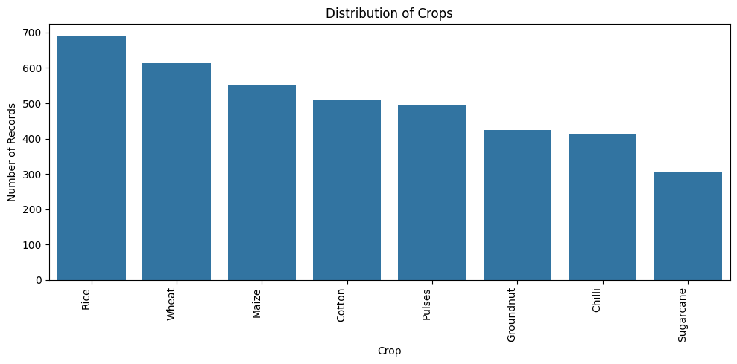
RESULTS
[Add screen shots of your code ]

Slide 8
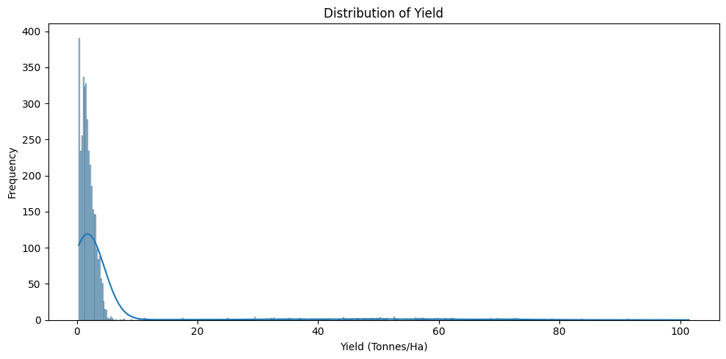
RESULTS
[Add screen shots of your code ]

Slide 9
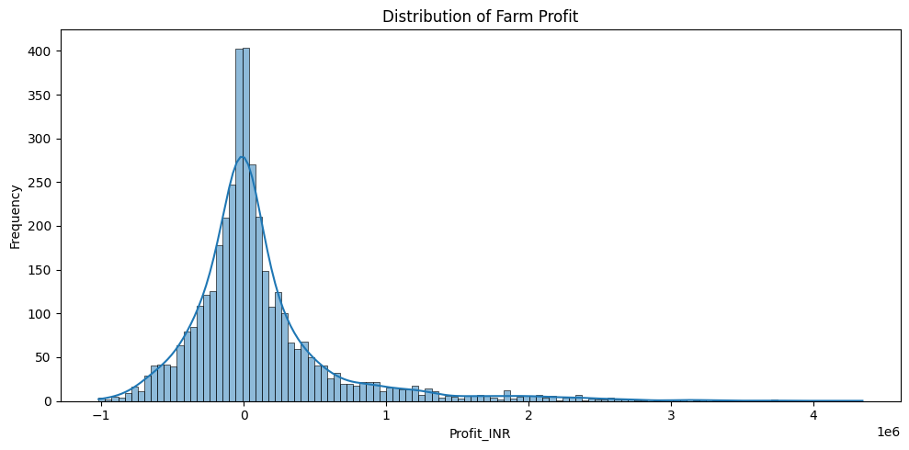
RESULTS
[Add screen shots of your code ]

Slide 10
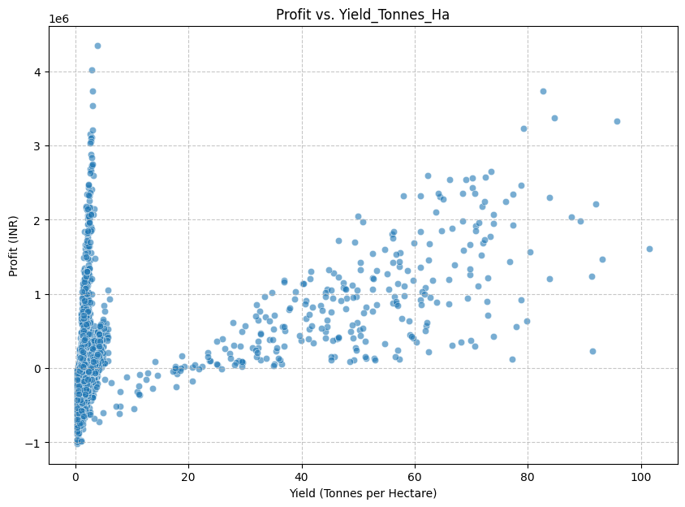
RESULTS
[Add screen shots of your code ]

Slide 11
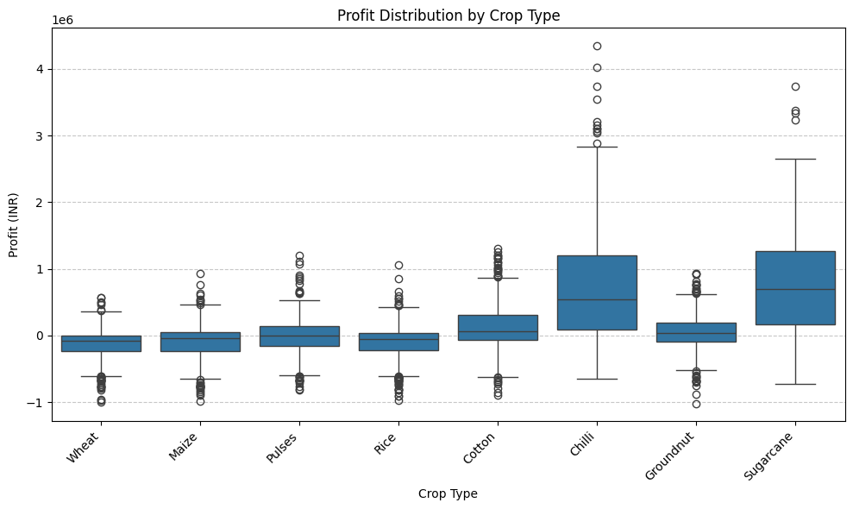
RESULTS
[Add screen shots of your code ]

Slide 12
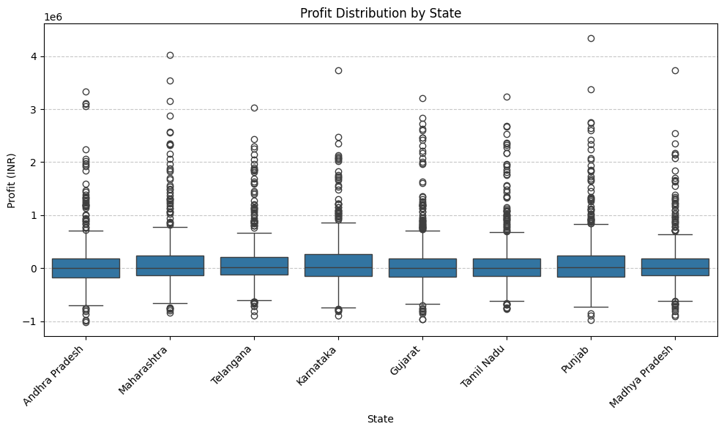
RESULTS
[Add screen shots of your code ]

Slide 13
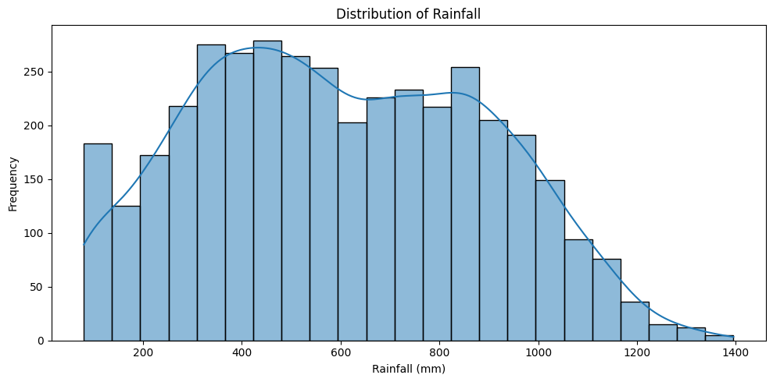
RESULTS
[Add screen shots of your code ]

Slide 14
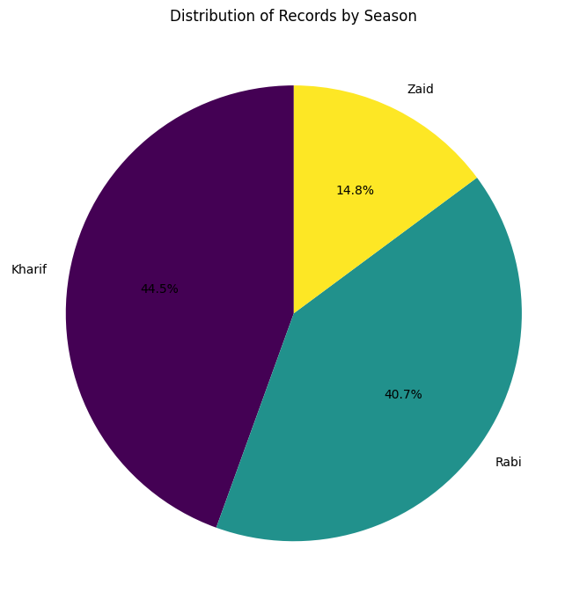
RESULTS
[Add screen shots of your code ]

Slide 15
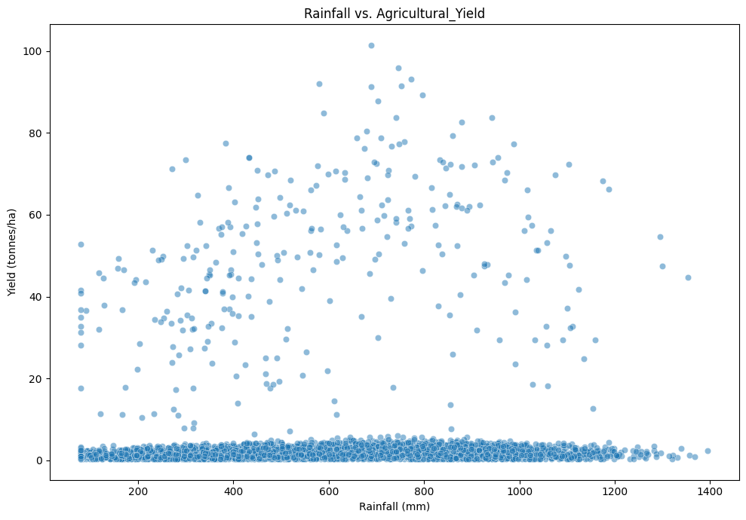
RESULTS
[Add screen shots of your code ]

Slide 16
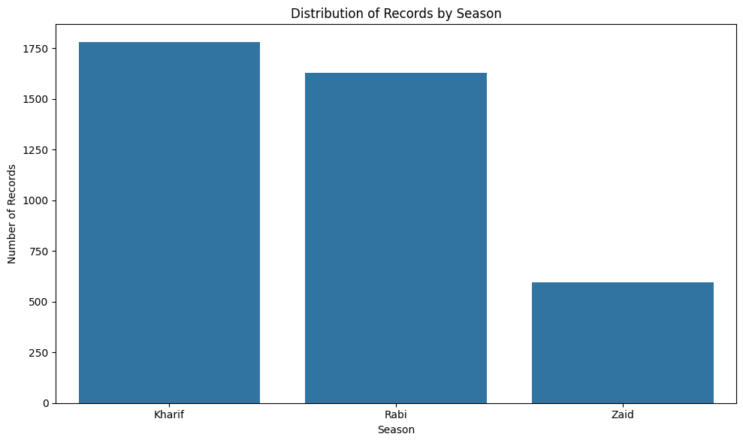
RESULTS
[Add screen shots of your code ]

Slide 17
Future scope
(The future scope of this project could involve developing predictive models for crop yield and profit based on seasonal factors, integrating real-time weather data for dynamic recommendations, and optimizing resource allocation (e.g., water, fertilizers) to maximize agricultural output and profitability across different seasons. Further analysis could also explore the impact of climate change scenarios on seasonal agricultural performance and propose adaptive strategies.

Slide 18
GitHub Link
https://github.com/manjilagamacharyya-glitch/Seasonal-Agriculture-Performance-Analysis

Slide 19
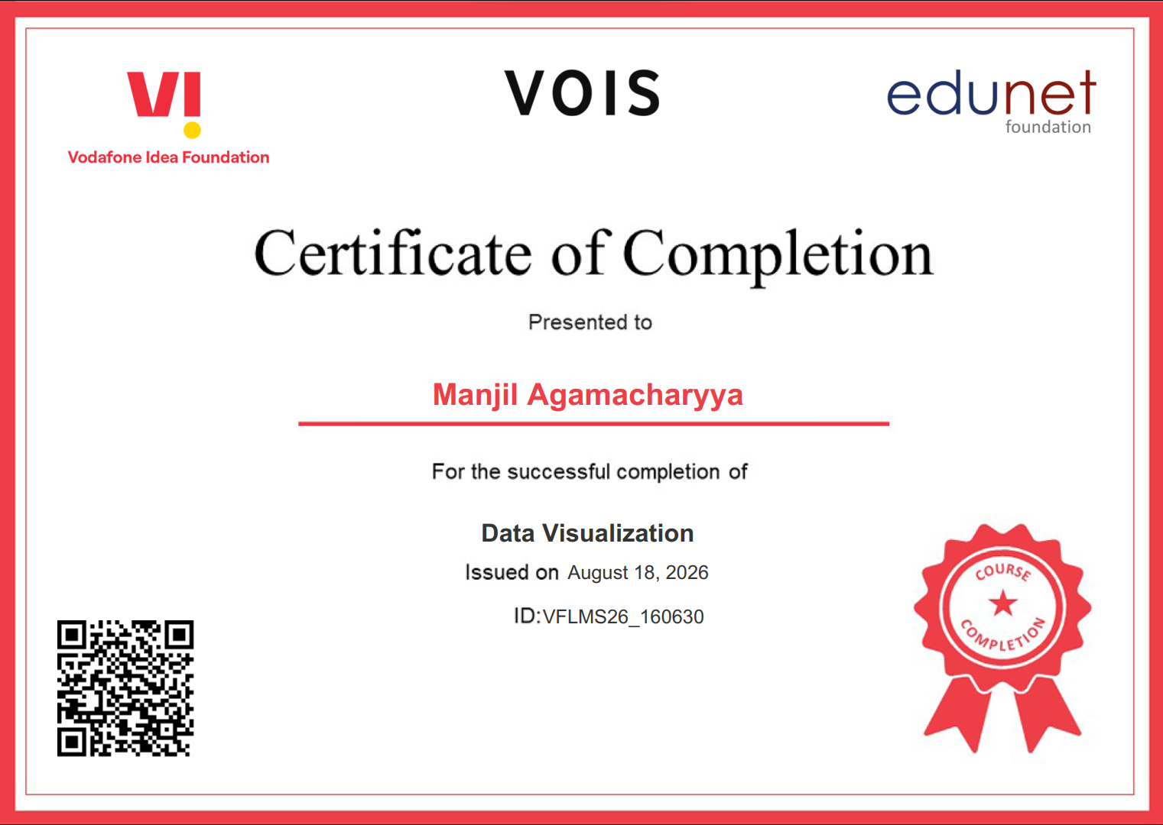
VOIS Course completion certificate -
Course name- Data Visualization

Slide 20
Thank you
.
.

